Slide 1
MUNA Matrimonial Site
Admin Guideline

Slide 2
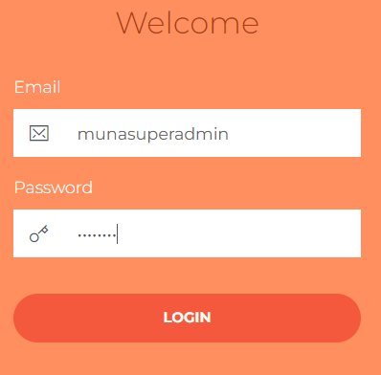
Admin URL
https://munamatrimonial.com/adminmuna24434/#/admin
Pass: muna1234

Slide 3
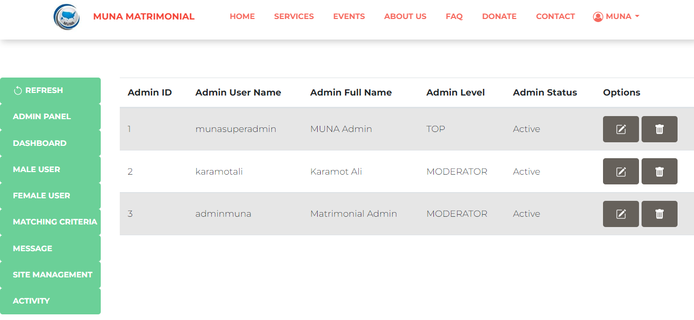
Admin Home

Slide 4
Admin Panel

Slide 5
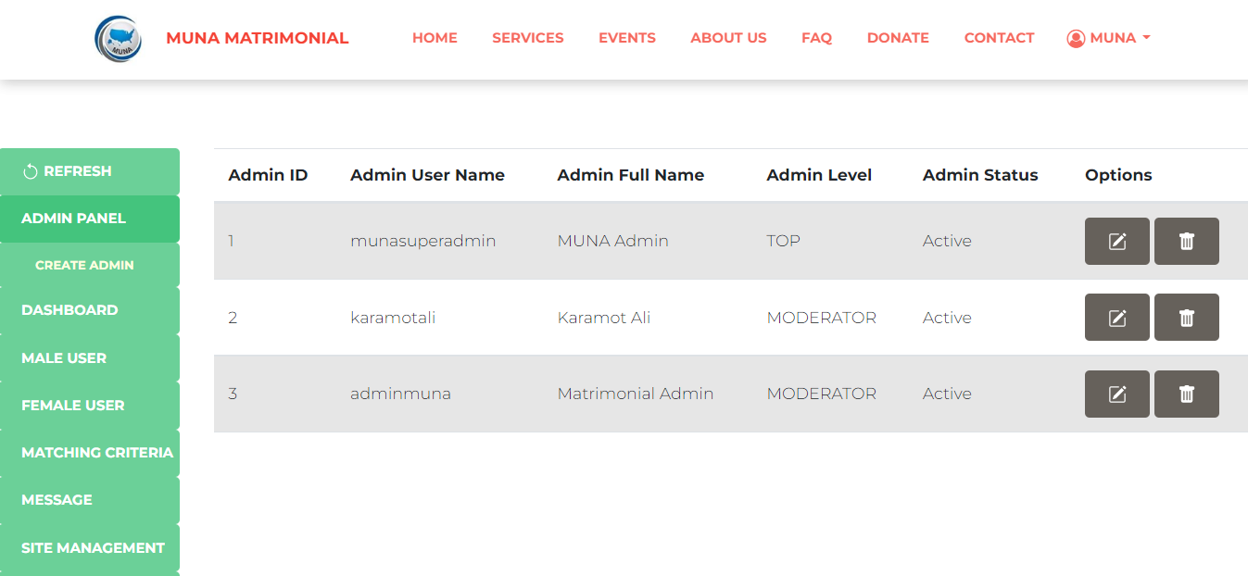
Admin Panel

Slide 6
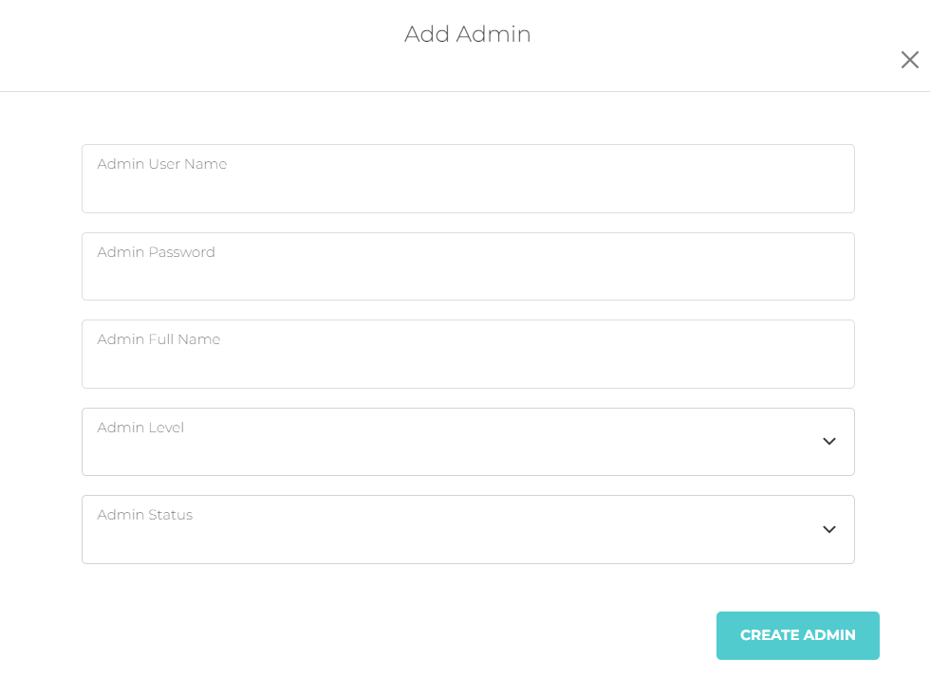
Create Admin

Slide 7
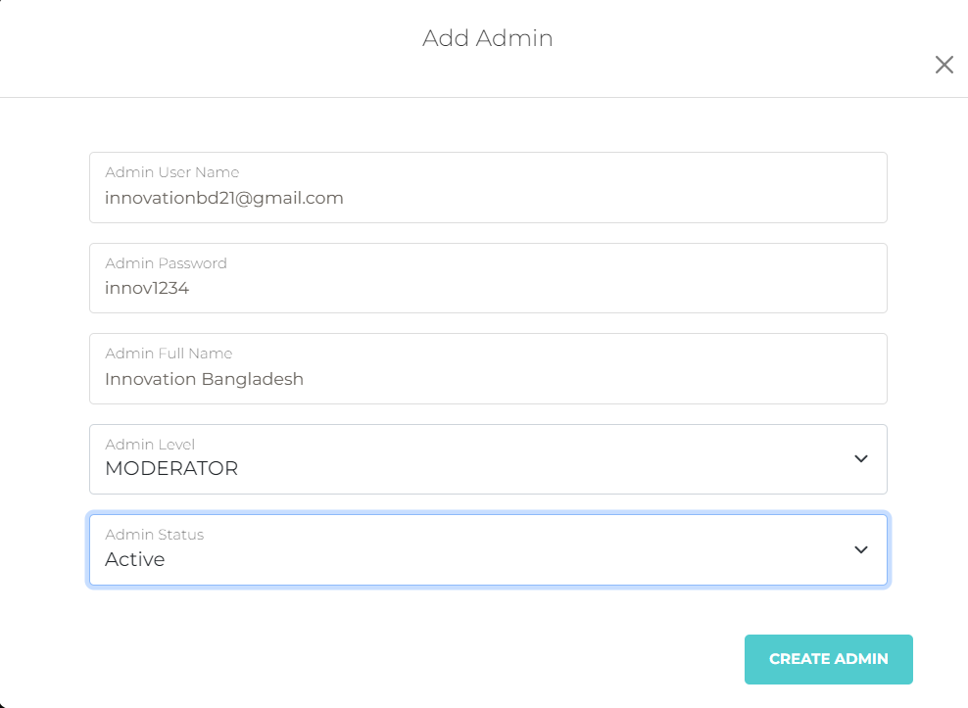
Create Admin

Slide 8
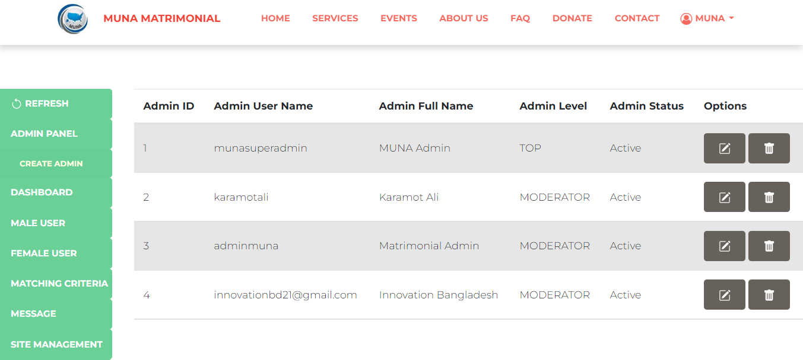
Edit Admin

Slide 9
Delete Admin

Slide 10
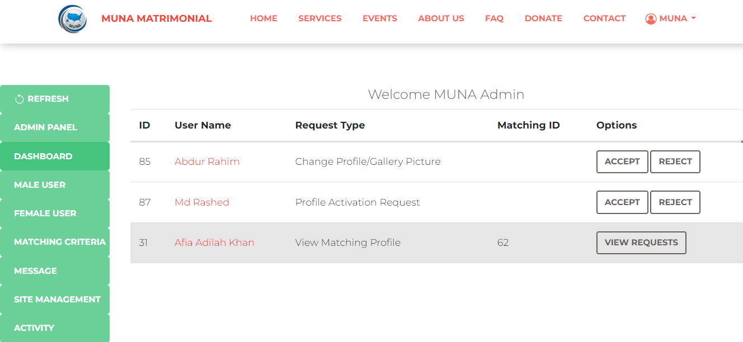
Dashboard

Slide 11
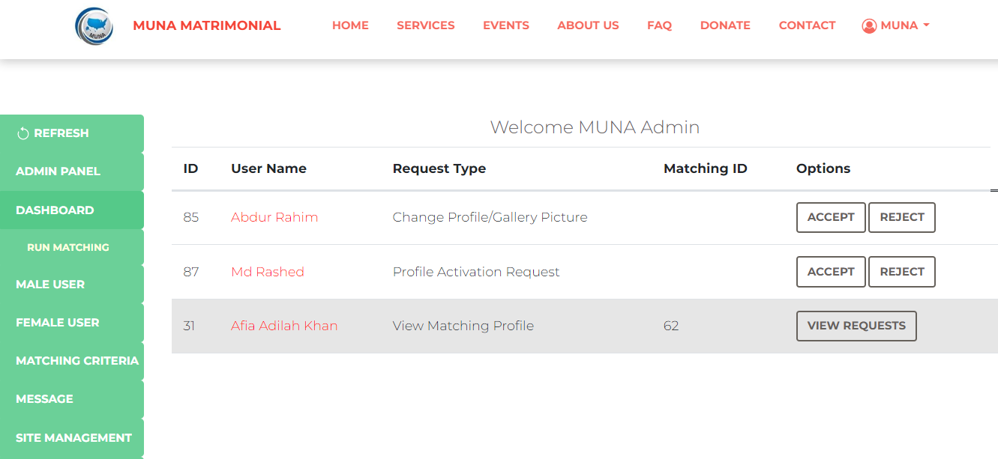
Run Matching Admin should run Matching everyday

Slide 12
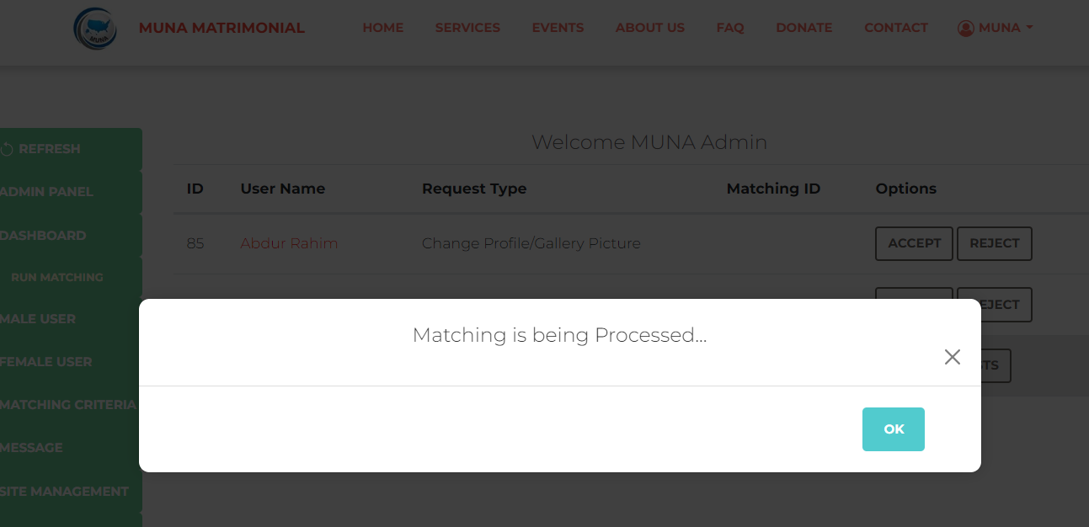
Run Matching Admin should run Matching everyday

Slide 13
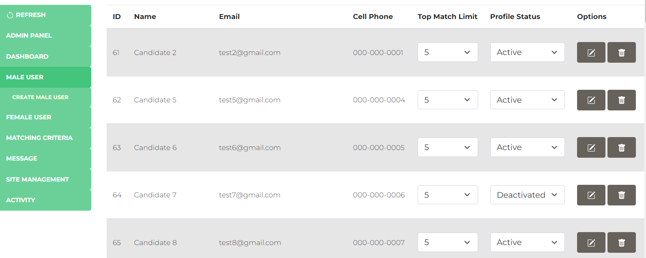
Male Users

Slide 14
Create Male Users Admin can create user arbitrarily for testing

Slide 15
Edit/Delete Male Users

Slide 16
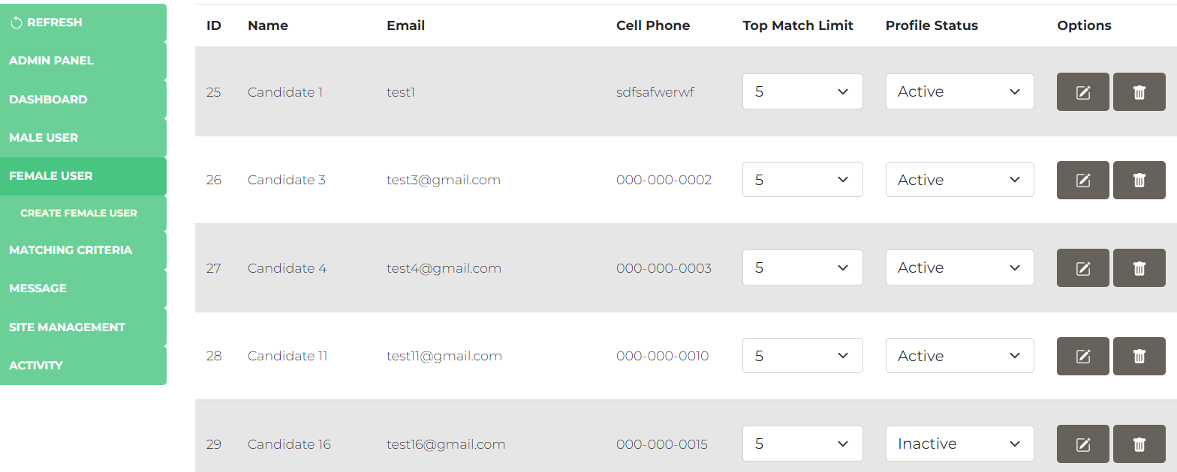
Similar Functions for Female Users also

Slide 17
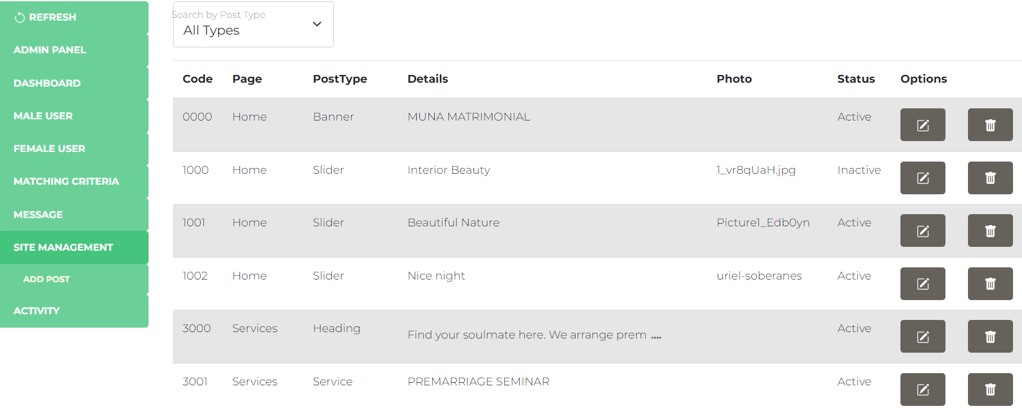
Site Management To edit home page contents

Slide 18
Add Post

Slide 19
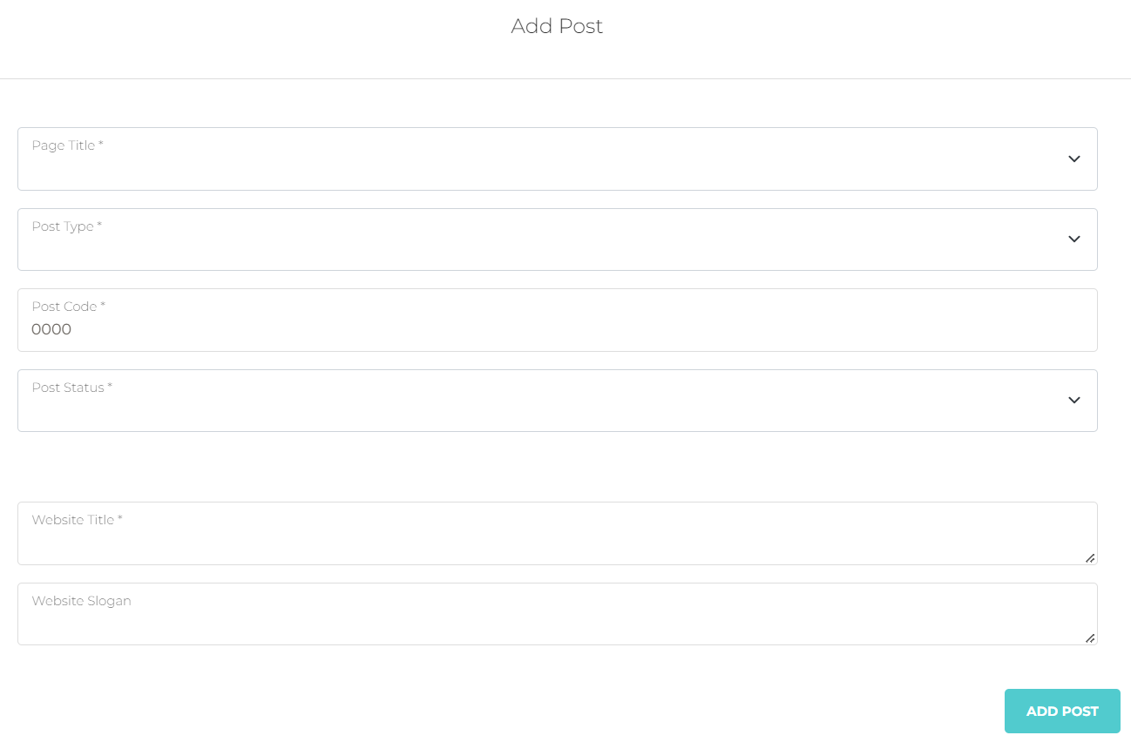
Add Post

Slide 20
Add Post

Slide 21
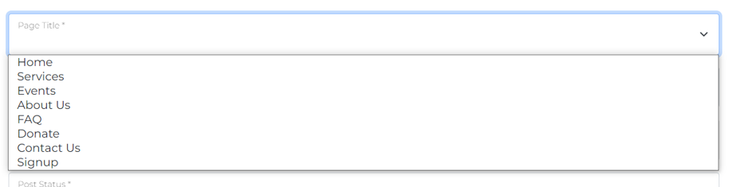
Add Post
There are several pages, select a page to add content to that page

Slide 22
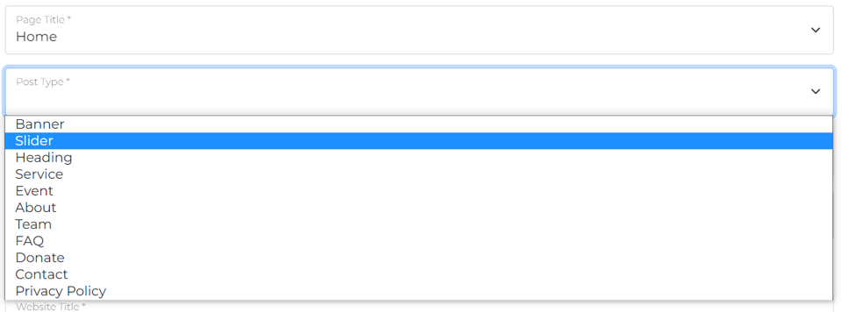
Add Post
There are several types of posts, select a post type to add content

Slide 23
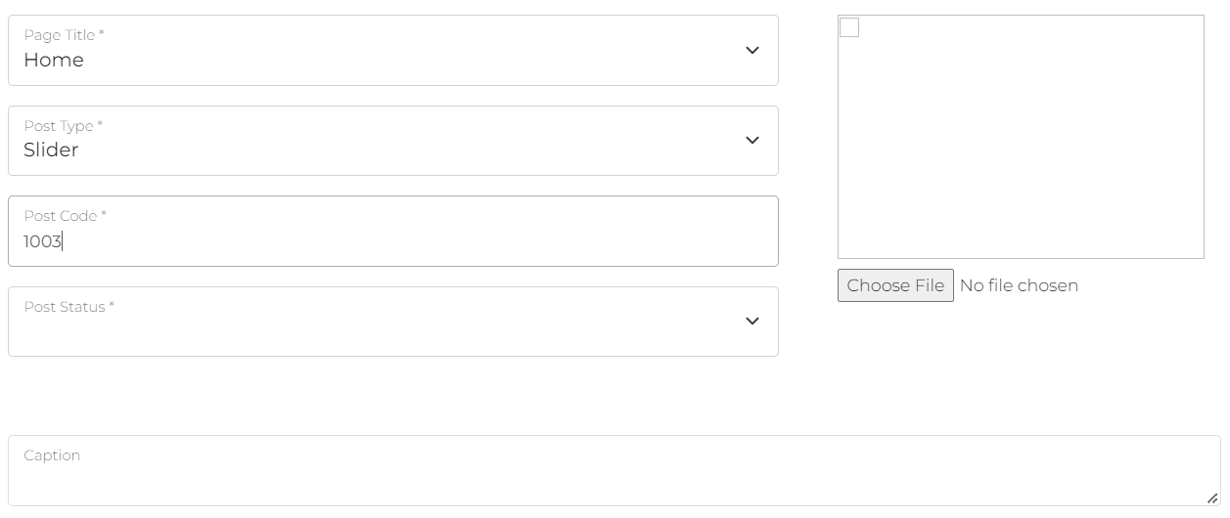
Add Post
No need to edit Post Code. It will generate automatically.

Slide 24
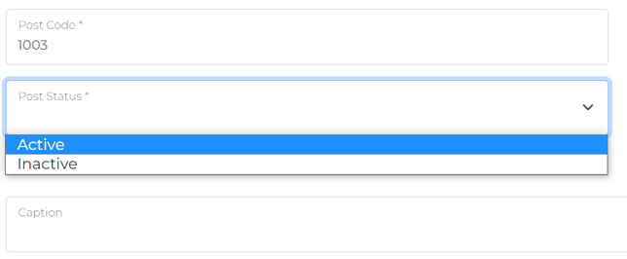
Add Post
Select Post Status as “Active”. If “Inactive” is selected, that content will not be visible

Slide 25
Add Post
Browse photo if required. Here, we select post type “Slider”, so we must upload photo that will be shown as slider.

Slide 26
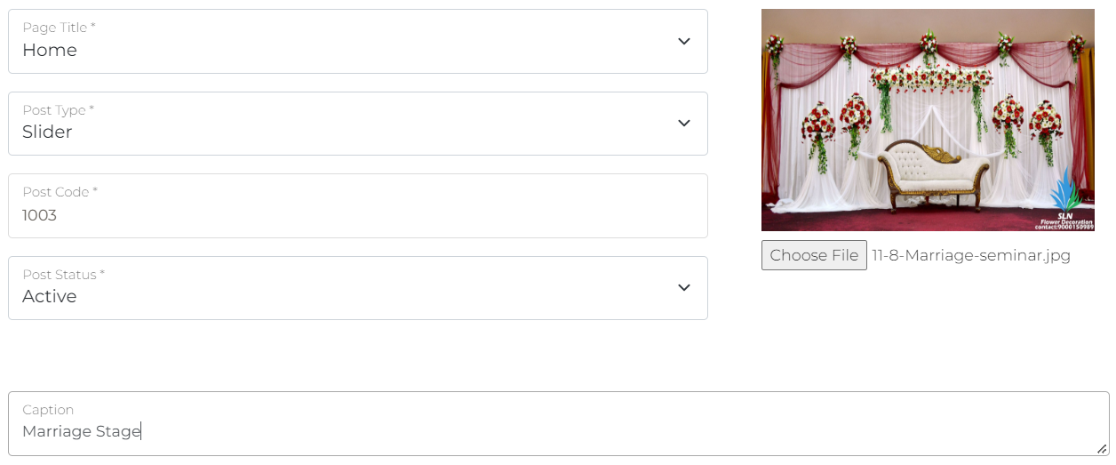
Add Post You may add Necessary Details for the Post (Here, for Post Type “Slider”, detail is only “Caption”)
You may add Necessary Details for the Post (Here, for Post Type “Slider”, detail is only “Caption”)

Slide 27
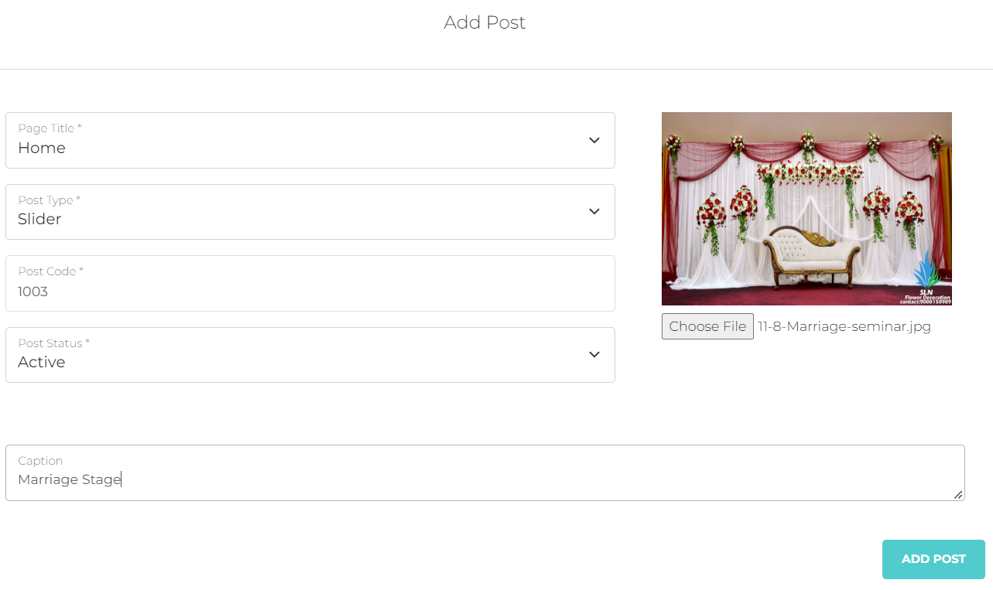
Add Post You may add Necessary Details for the Post (Here, for Post Type “Slider”, detail is only “Caption”)

Slide 28
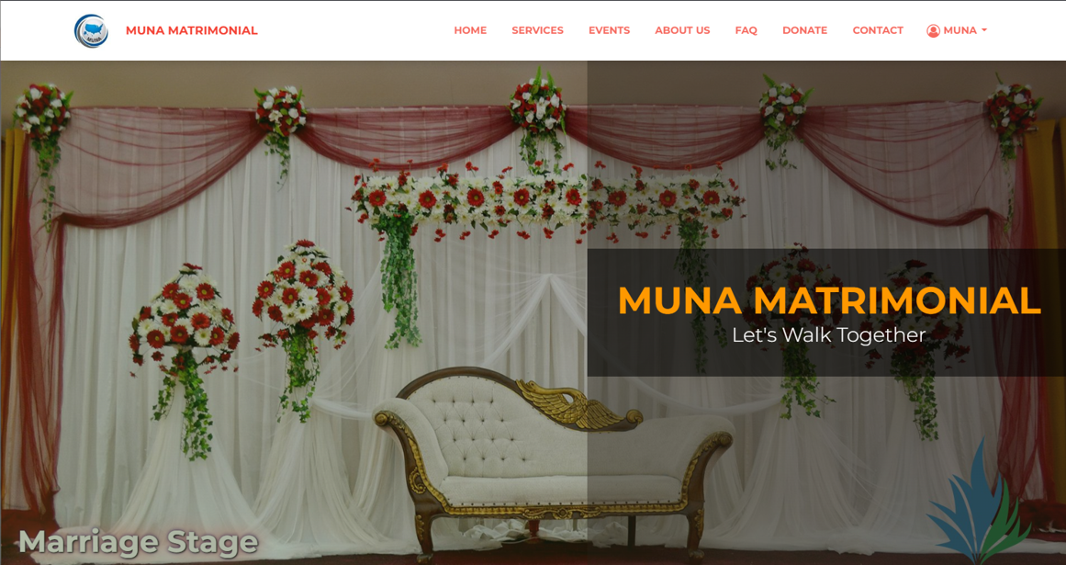
Slider has been Added!

Slide 29
Edit Post Any post can be edited in a similar way

Slide 30
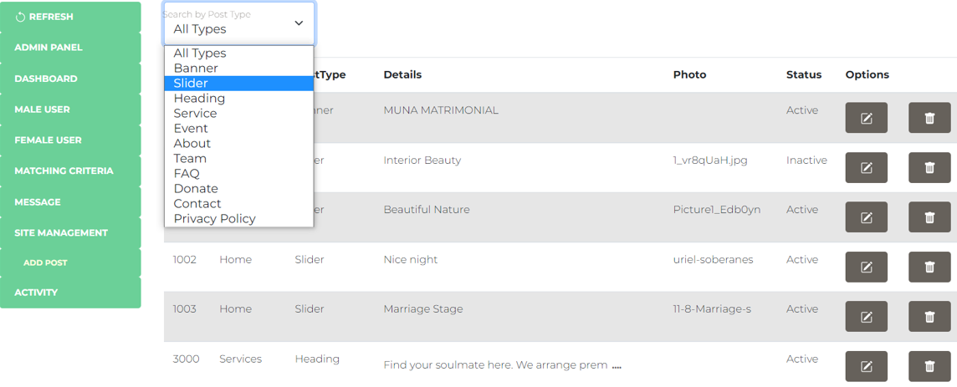
You may Filter by Post Type to view only the Specific Post Type

Slide 31
Site Management
You may edit site contents by the following sets of
Page Title
Post Type
And Description

Slide 32
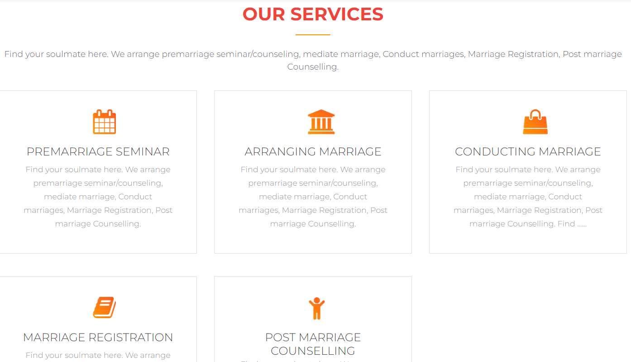
Page Title = Services
Post Type = Heading
Description: Heading

Slide 33
Service Icon
Service Name
Page Title = Services
Post Type = Service
Description:
Service Name
Service Icon
Service Details
Service Details

Slide 34

Page Title = Events
Post Type = Heading
Description: Heading

Slide 35
Page Title = Events
Post Type = Event
Description:
Caption
Date & Time
Event Venue
Event Details

Slide 36

Caption
Date and Time

Slide 37
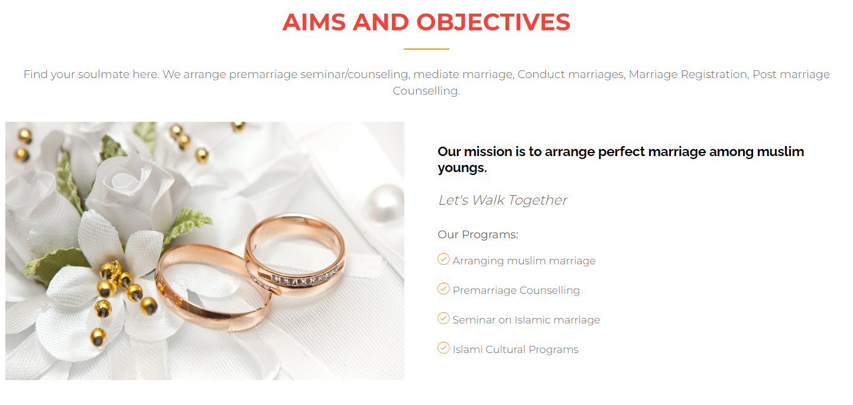
Page Title = About Us
Post Type = Heading
Description: Heading

Slide 38
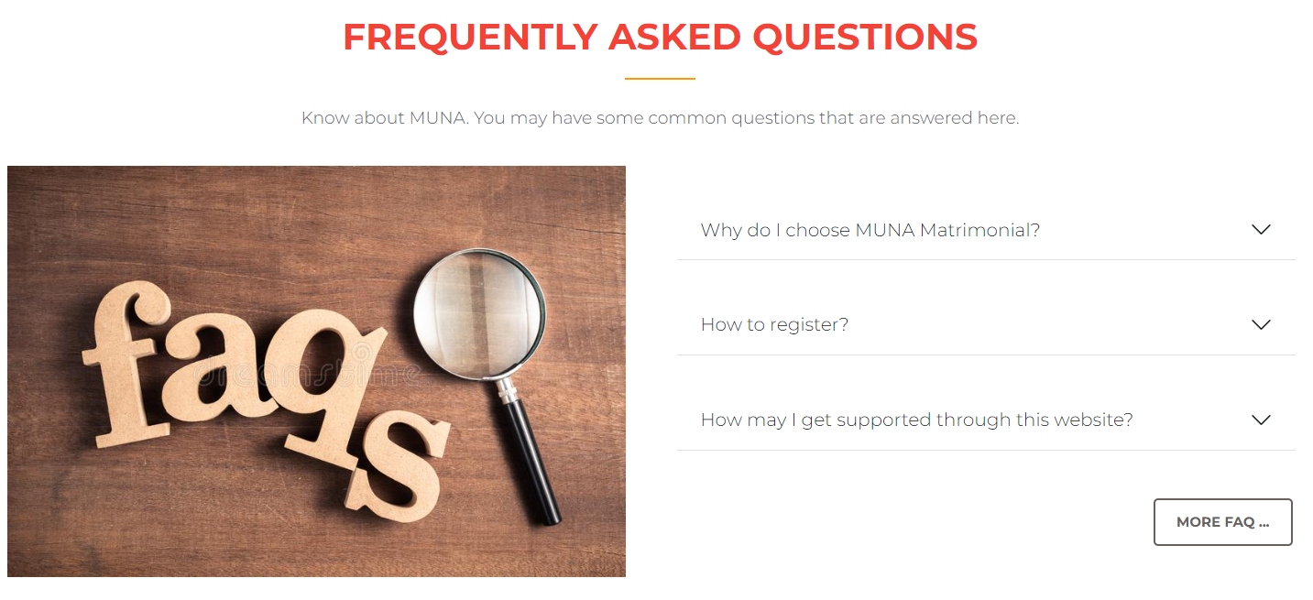
Page Title = FAQ
Post Type = Heading
Description: Heading

Slide 39
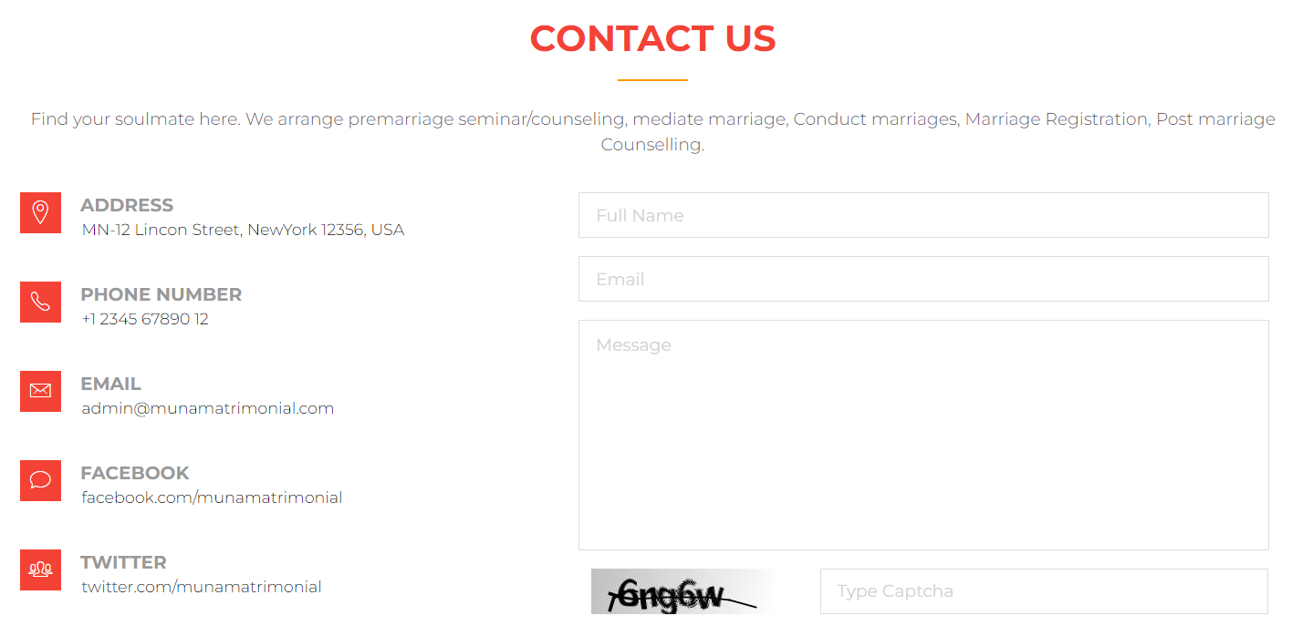
Page Title = Contact Us
Post Type = Heading
Description: Heading

